Slide 1
HALO Simulation
Keith Condray-Raderstorf, Srikar Namburi, Heinrich Maertens

Slide 2
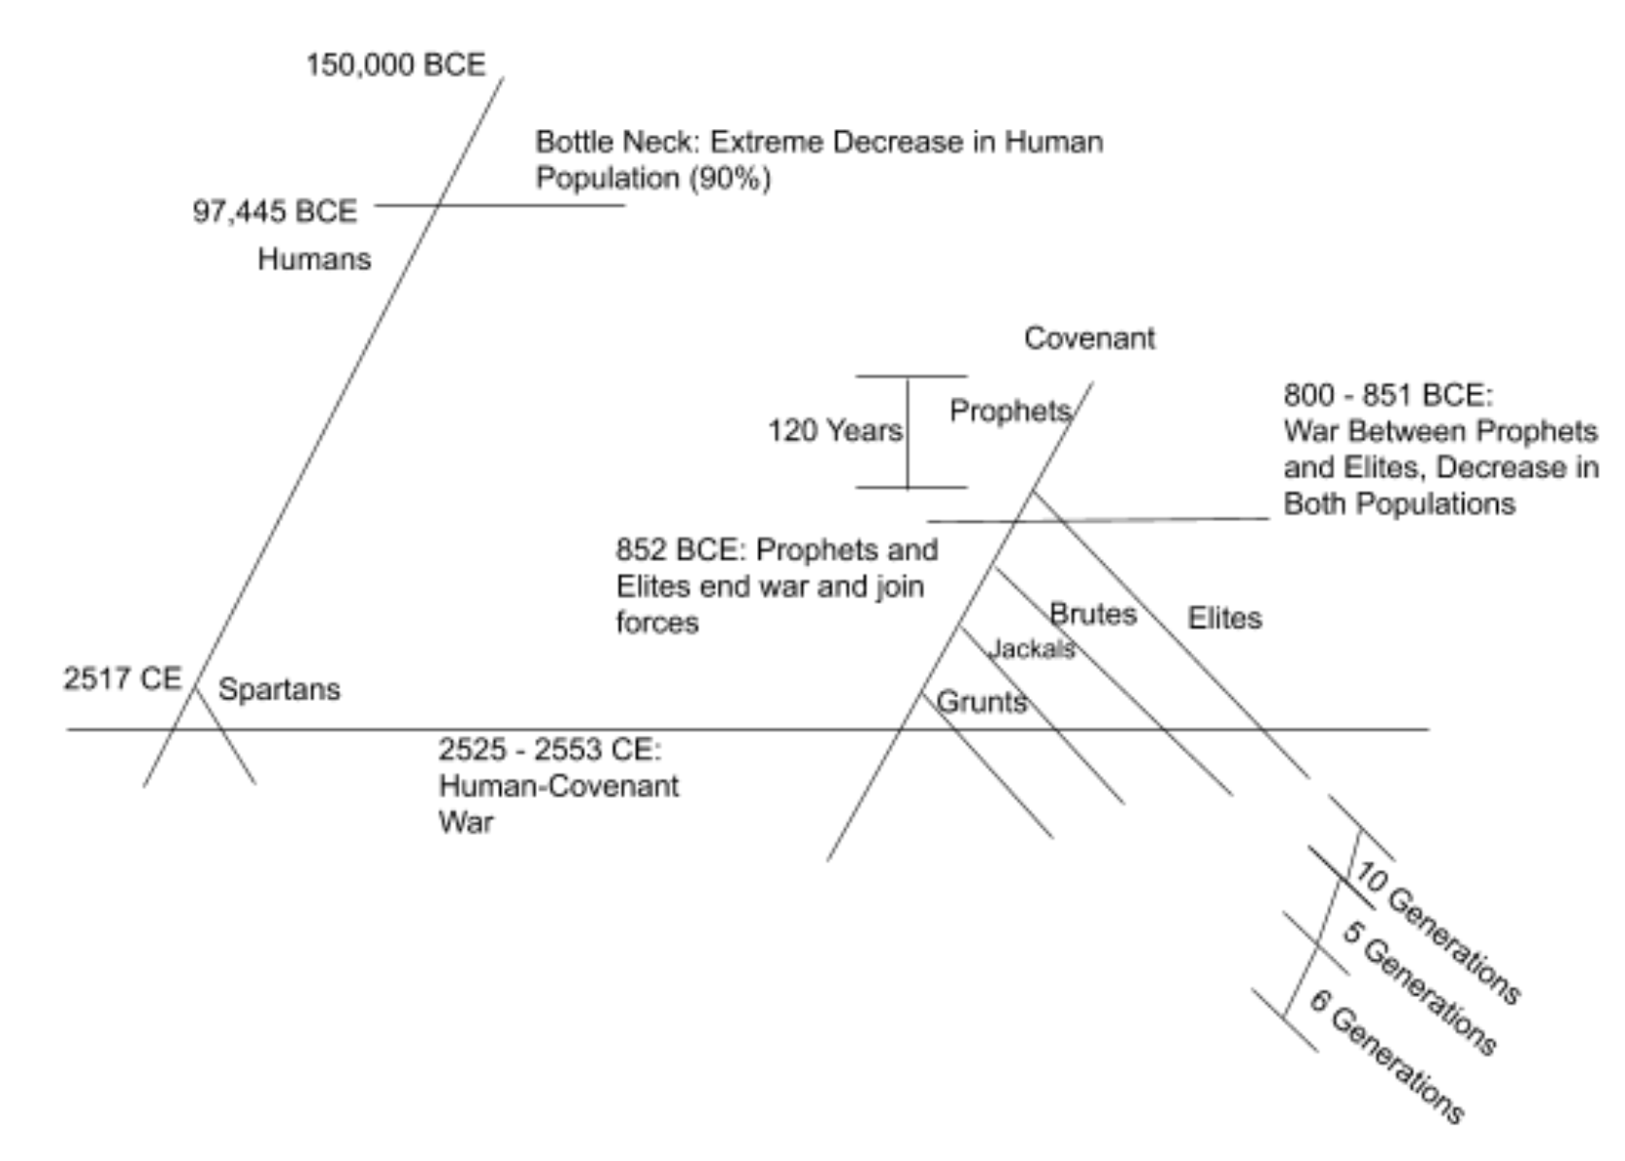
Our Timeline
Notes:
Two seperate population trees, one starting with humans the other with prophets but introduced later. Simulated multiple bottlenecks as shown in the figure with the horizontal lines such as the “extreme decrease in human population” labeled one.

Slide 3
Genome Sections
ACTG1
Strength
GRM5
Endurance
MC4R
Mobility
Opsin
Accuracy
DLG3
Memory Recall
LHX2
Fur
Notes:
Total genome length: 850’000
Genes had different recombination rates. Tried to model them of the existing genes that researchers have found - length and introns & exons.
We had different mutations for each section of the genome to better control which species did ‘better’ in them. An example of this would be Spartans, Elites and Brutes having every mutation that appears be better than the standard for others. We did this using the fitness function.

Slide 4
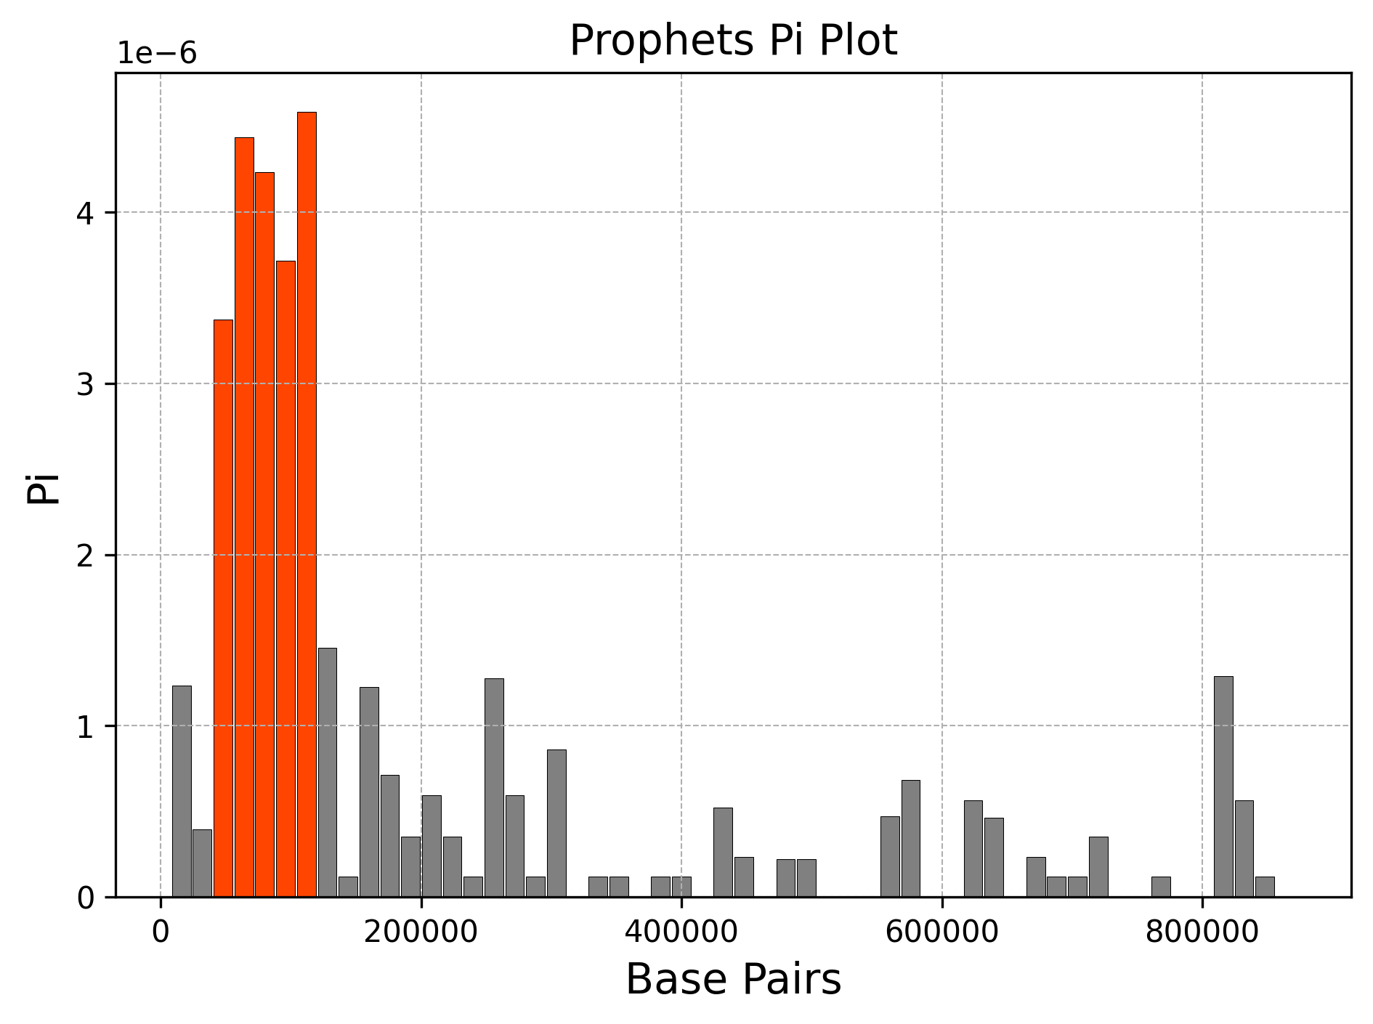
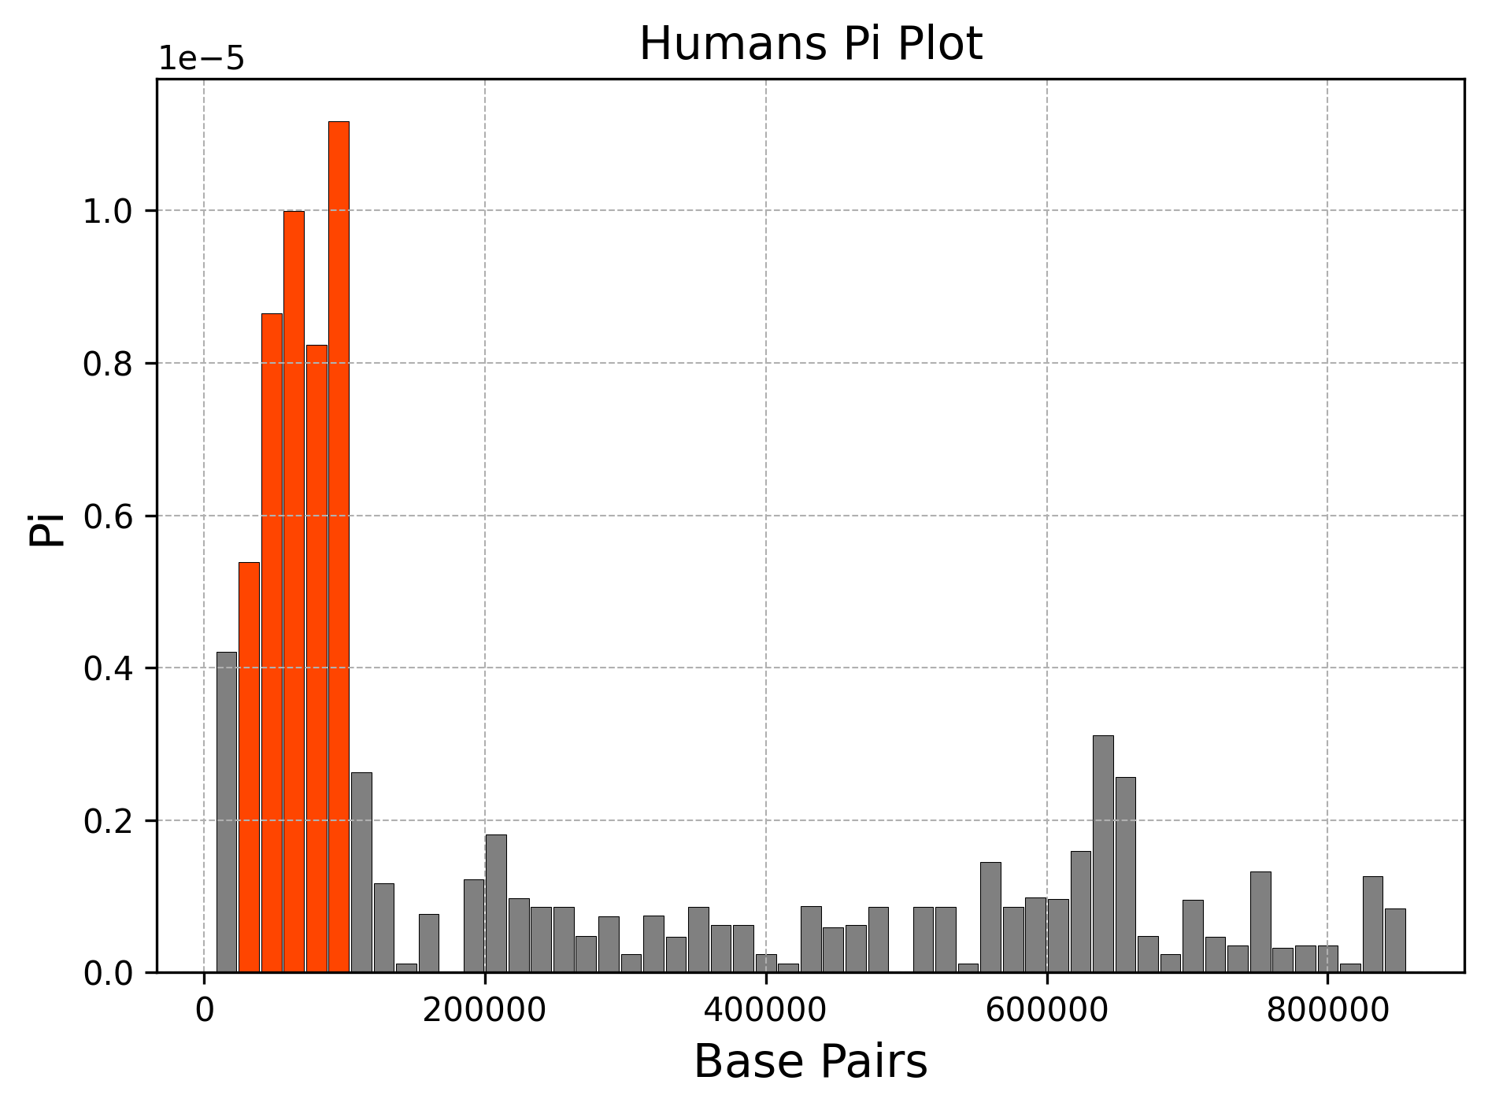
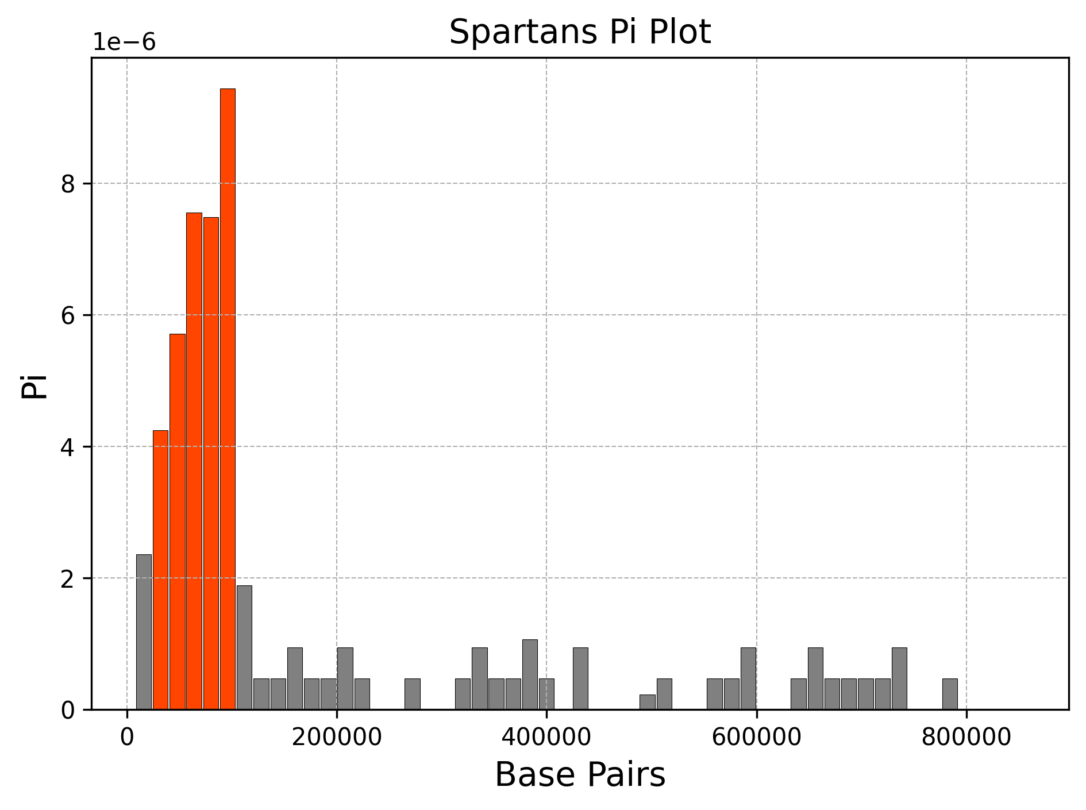
Pi Plots
Notes:
Pi is calculated by finding the average number of nucleotide differences between DNA sequences for all possible pairs. In other words, it is a measure of genetic variation. Through the SLiM program, we were able to look at how many individuals contained a certain gene and then multiplied that number by how many people didn’t have that gene. We continued to do this all the way to the end, and then divided the whole number by
(N 2). Later on, we split these into windows through the MatplotLib package in python and were able to arrive with Figures 1-7. Looking at Figures 1-7, there are two clear patterns that the Pi figures show. In Group 1, a pattern appears between prophets, humans and Spartans while in Group 2, a different pattern appears between brutes, elites, jackals, and grunts. The common feature in Group 1 is that the data is unimodal and skewed to the right. This indicates that a selective sweep may have wiped out the genes with the exception of the gene in the beginning. A sweep is basically when a beneficial mutation increases in frequency and becomes fixed. This then leads to a lower genetic variation which is what the graph is showing.

Slide 5
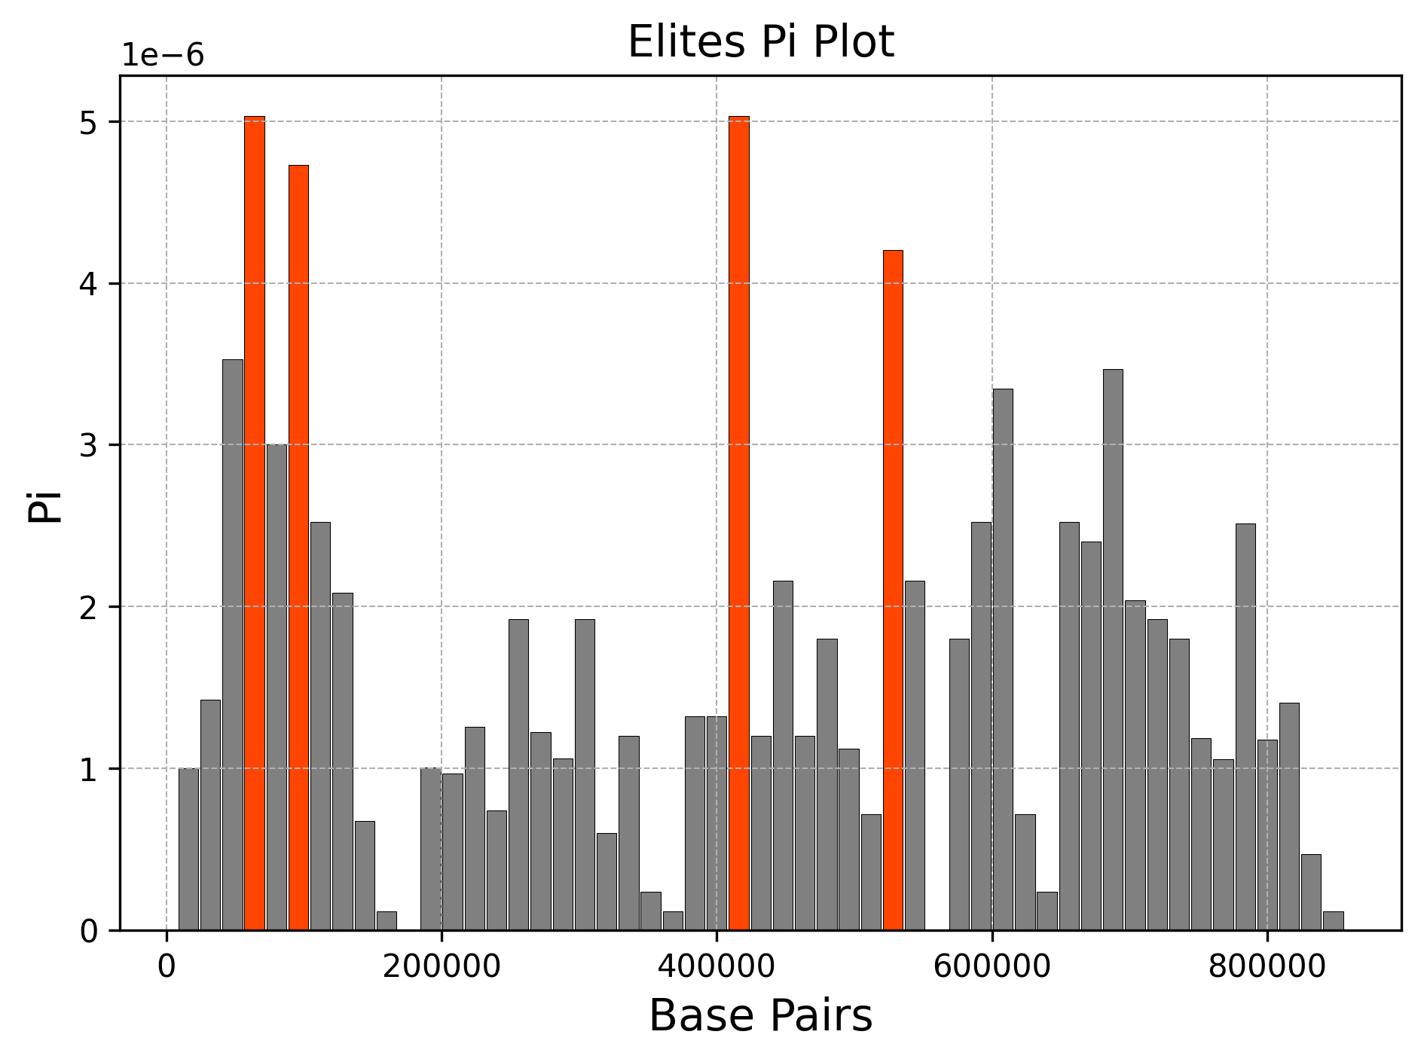
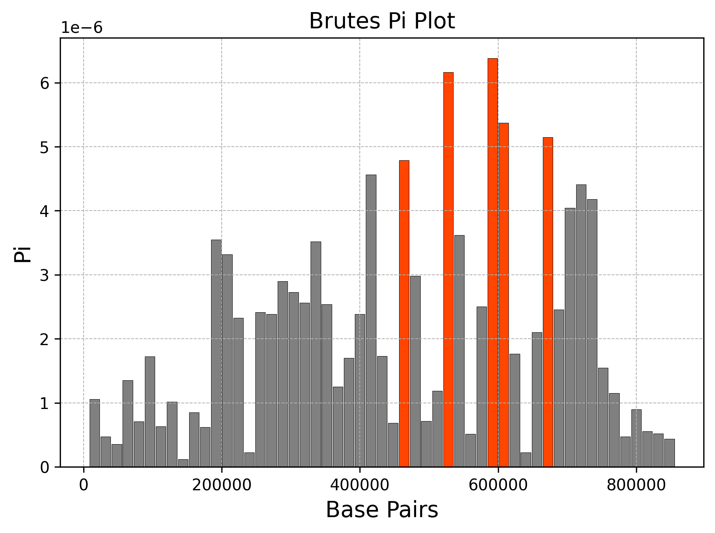
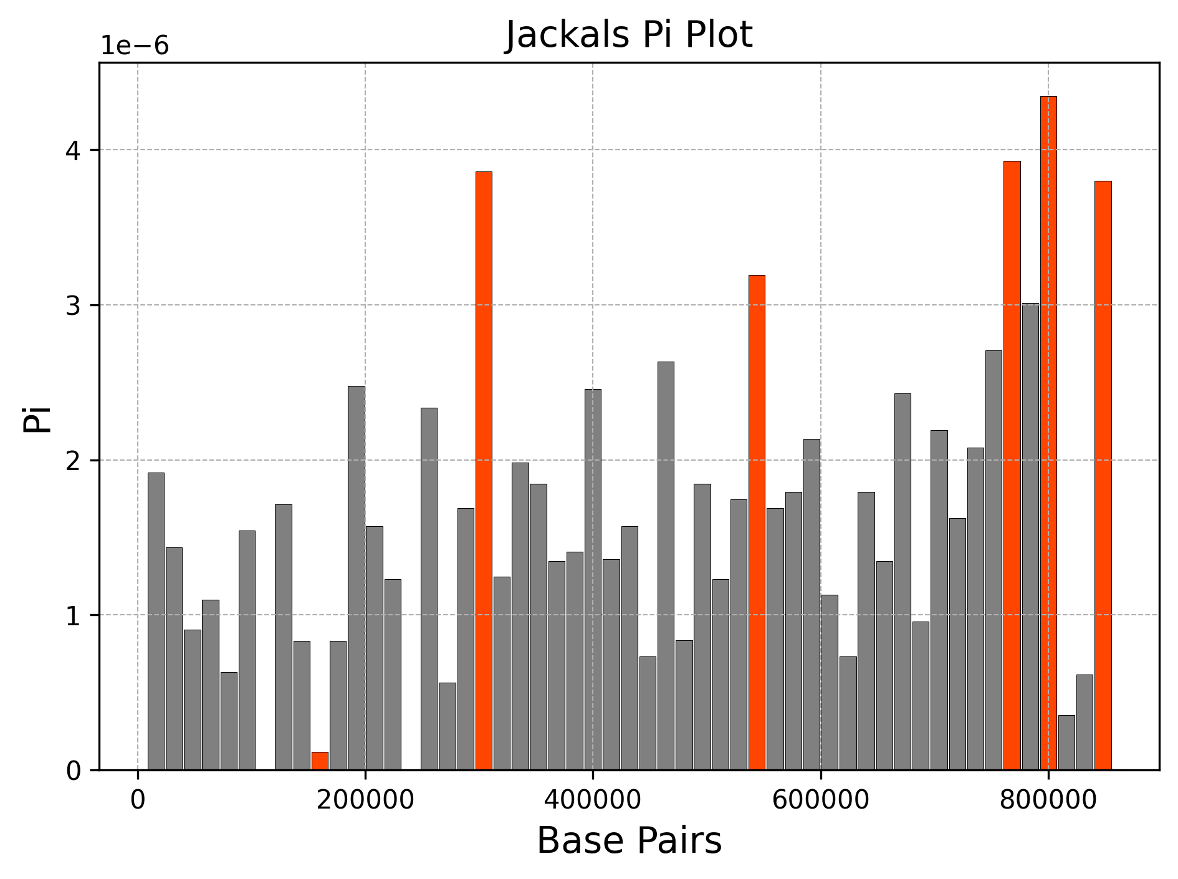
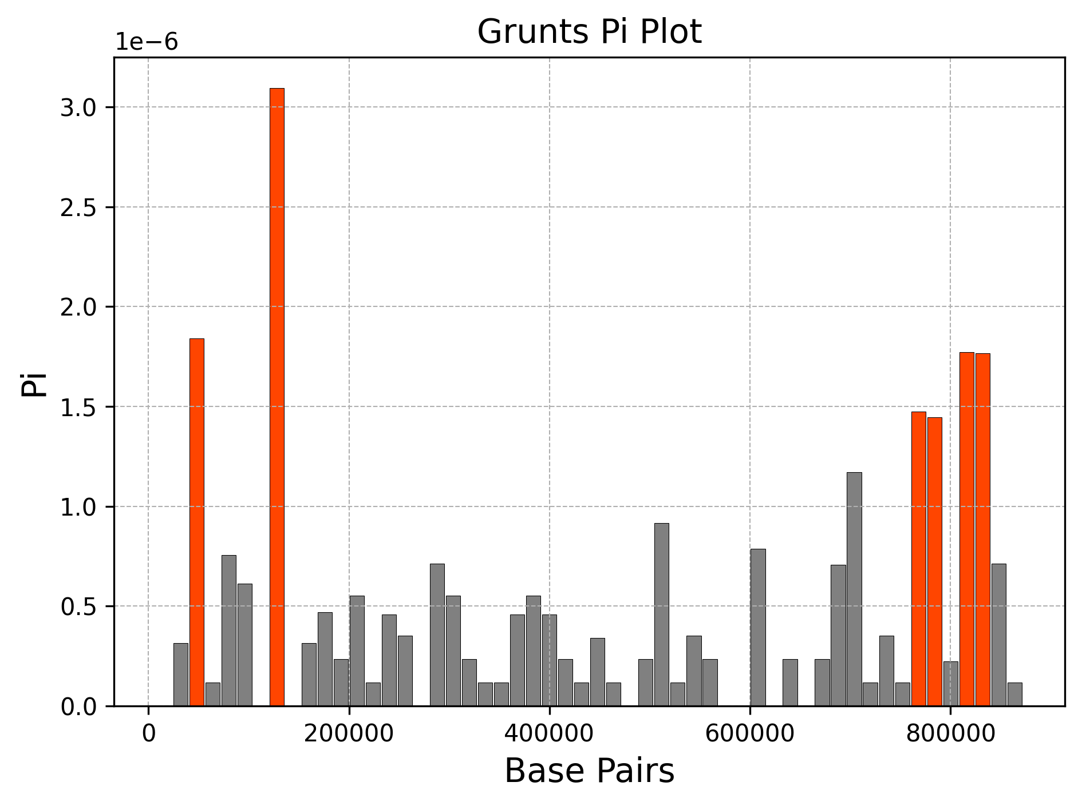
Notes:
In Group 2, the blue bars(the bars that are significantly different from the rest) are much more widespread and vary in length. Interestingly, looking at the number of grey bars and the range, the Brutes and Elites have the highest Pi and range in Group 2, and then follows Jackals, and lastly Grunts. From this order, we can draw that Brutes and Elites first arrived in the timeline, then Jackals, and finally Grunts in the overall time period. Also with these two groups, we know that the group’s population arrived from a common ancestor and are thus similar in many ways. Especially looking at Humans and Spartans, the Pi plots look exactly the same but the Human Pi plot has a larger range compared to the Spartans and so we can assume that humans came first and then Spartans followed.

Slide 6
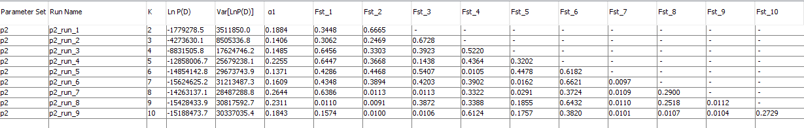
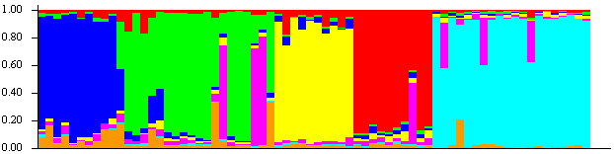
Structure Data: Full Simulation
K=7

Slide 7
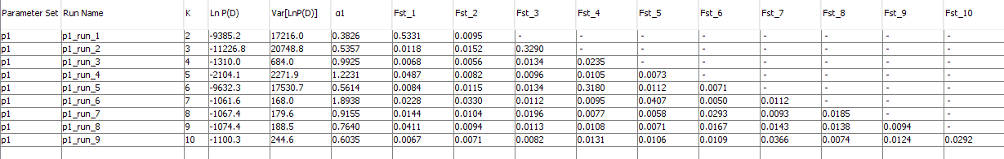
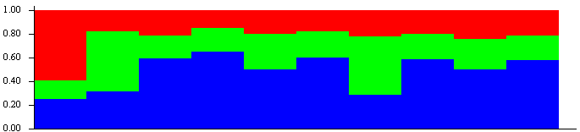
Structure Data: Grunts
K=3

Slide 8
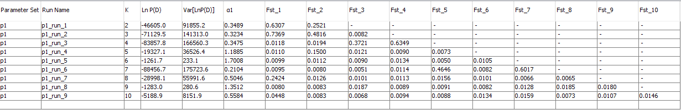
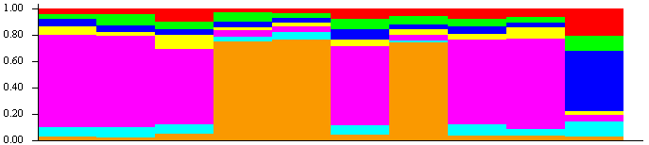
Structure Data: Spartans
K=7

Slide 9
Population Sizes
Pop Name | Ne | End N
Brutes | 285 | 170
Elites | 223 | 180
Grunts | 66 | 130
Humans | 216 | 700
Jackals | 222 | 140
Prophets | 91 | 190
Spartans | 139 | 10

Slide 10
Thanks!

